Slide 1
Existing Problem
Many people actually end up over washing their hands (over 15- 20 seconds with full tap released). When we turn on a tap only 10 – 30% water actually touches our skin and rest just flows over this first layer of water.
Disinfection actually just requires that water reaches every millimeter of your hand along with a disinfectant or soap and it should be just enough to kill any infection or help it slide out of your hand.

Slide 2
Dry Hand washing Machine By Fog Disinfection (Solution)
Our machine goes ahead another level to enable even more water saving using a fog based system.
The tank is filled with water along with any safe herbal disinfectant liquid if required.
When the user rubs his/her hands and inserts it into the system, this automatically triggers a water fogging system that converts water in the tank to fog and drives it in the hand wash chamber.

Slide 3
Solution (Cont..)
The machine consists of a fan to drive in air that is needed to drive the fog into hand wash chamber
Now Fog has the ability to reach all corners of the hand in less than 5 seconds as it is in gaseous state (water vapor).
After 5- 15 seconds of water fog exposure the soap on users hand is washed down with the fog.
This requires less than 95% of water that would be required in traditional tap based hand washing.

Slide 4
Block Diagram
DC
Fan
Soap Solution
Water
Tank 1
Tank 2
Fog
Maker
Fog
Maker
Door1
(Servo
Motor)
Door2
(Servo
Motor)
Arduino UNO
2-Channel
Relay
I2C Module
LCD Display
Ultrasonic Sensor

Slide 5
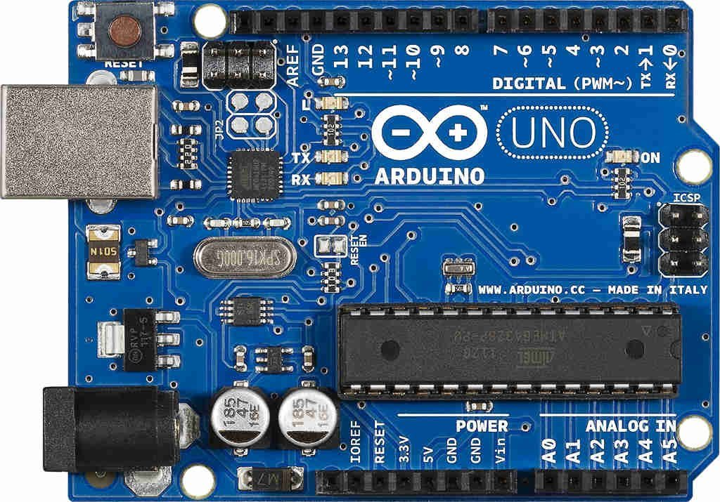
Circuit Description
Servo Motor 2
Servo Motor 1
-ve
+ve
PWM
-ve
+ve
PWM
DC
Fan
+
-
Fog
Maker
1
Fog
Maker
2
Relay
+
-
+
-
Ultrasonic Sensor
vcc
In1
In2
Gnd
Vcc
Trig
Echo
Gnd
Adapter
I2C
Module
+
-
Gnd
Vcc
SDM
SCL

Slide 6
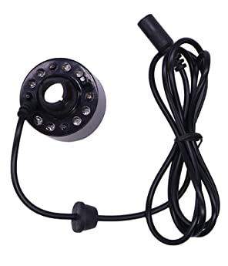
Fog Maker Working
Here we are using fog makers for two purposes:
First one is placed inside soap solution to produce soap fog for cleansing our hands with minimum water required.
Second one is placed inside water container to produce water fog so as to wash the soap solution off from the hands.

Slide 7
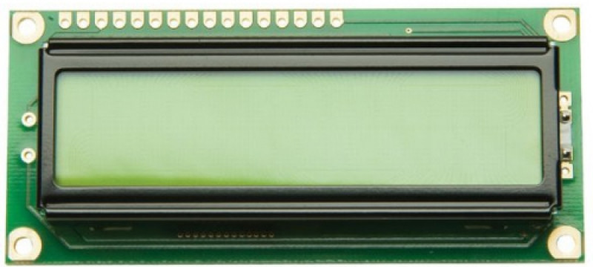
LCD Display Working
We are using Liquid crystal display that is LCD in our machine.
It is used here so as to show the proper working of the machine step by step.
Also it helps to make its working easy to understand by common or non technical people as well for wide range use.

Slide 8
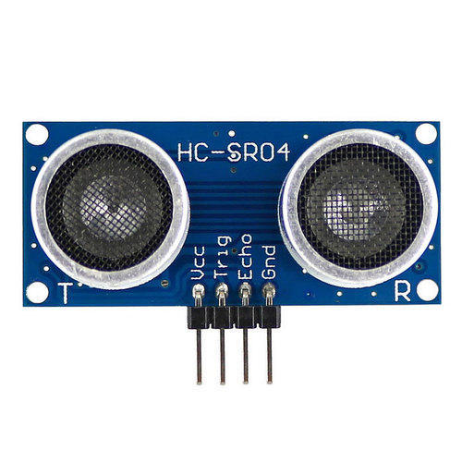
Ultrasonic Sensor Working
Ultrasonic sensor here is fixed over the machine just above the place where hand is to be inserted.
It is used to sense the movement of the person’s hand coming near it.
Its sensing will start the operation by first opening the door of the machine to allow hands to get inserted for further process.
Transmitter for
Ultrasonic Waves
VCC
Input (Trig)
Output (Echo)
Gnd
Receiver for
Ultrasonic Waves

Slide 9
Code Uploaded In Arduino UNO
#define TRIG_PIN 7 // connected to Ultrasonic Sensor's TRIG pin
#define ECHO_PIN 8 // connected to Ultrasonic Sensor's ECHO pin
#define SERVO_PIN1 4
#define SERVO_PIN2 3
#define RELAY_PIN1 6
#define RELAY_PIN2 5 // connected to Relay's pin
#define DISTANCE_THRESHOLD 50// centimeters
#include <Wire.h>
#include <Servo.h>
#include <LiquidCrystal_I2C.h>
LiquidCrystal_I2C lcd(0x27,16,2); // set the LCD address to 0x27 for a 16 chars and 2 line display

Slide 10
// Variables defined
float duration_us, distance_cm;
Servo servo1;
Servo servo2;
void setup() {
Serial.begin (9600);
servo1.attach(SERVO_PIN1);
servo1.write(0);
servo2.attach(SERVO_PIN2);
servo2.write(0);
// initialize serial port
pinMode(TRIG_PIN, OUTPUT);
pinMode(ECHO_PIN, INPUT);
pinMode(RELAY_PIN1, OUTPUT);
pinMode(RELAY_PIN2, OUTPUT);

Slide 11
lcd.init(); // initialize the lcd
lcd.backlight();
}
void loop() {
// generate 10-microsecond pulse to TRIG pin
digitalWrite(TRIG_PIN, HIGH);
delayMicroseconds(10);
digitalWrite(TRIG_PIN, LOW);
// measure duration of pulse from ECHO pin
duration_us = pulseIn(ECHO_PIN, HIGH);
// calculate the distance
distance_cm = 0.017 * duration_us;
if (distance_cm < DISTANCE_THRESHOLD)
{
servo1.write(150);
servo2.write(0);

Slide 12
digitalWrite(RELAY_PIN1, HIGH); // turn on Relay
digitalWrite(RELAY_PIN2, LOW); // turn off Relay
digitalWrite(4,HIGH);
lcd.setCursor(0,0);
lcd.print("Soap.");
delay(15000);
lcd.clear();
lcd.setCursor(0,0);
lcd.print("Water.");
digitalWrite(RELAY_PIN2, HIGH); // turn on Relay
digitalWrite(RELAY_PIN1, LOW); // turn off Relay
delay(15000);
lcd.clear();
}
else
{
servo1.write(0);
servo2.write(150);

Slide 13
lcd.setCursor(0,0);
lcd.print("System off!");
digitalWrite(4,LOW);
digitalWrite(RELAY_PIN1, HIGH); // turn off Relay
digitalWrite(RELAY_PIN2, HIGH); // turn off Relay
delay(1000);
lcd.clear();
}
// print the value to Serial Monitor
Serial.print("distance: ");
Serial.print(distance_cm);
Serial.println("cm");
delay(500);
}

Slide 14
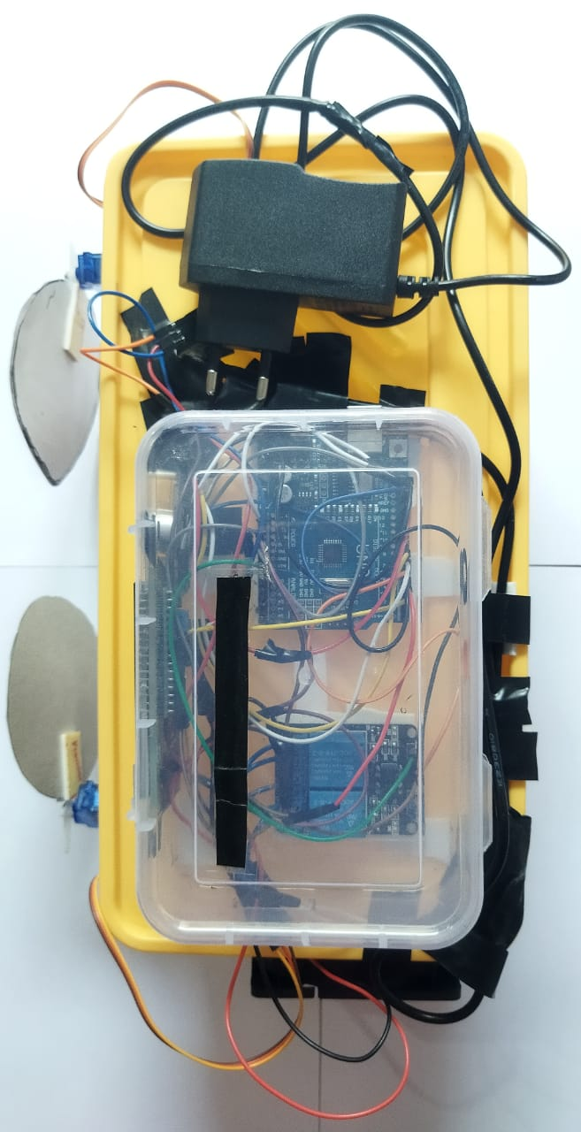
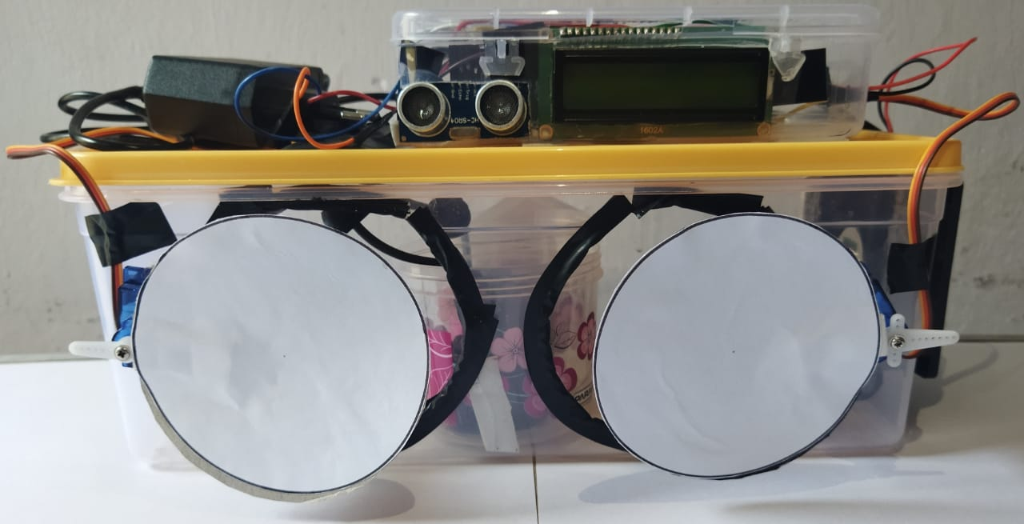
Hardware description
Front view of hand washing system
Top view of hand washing system

Slide 15
Future Scope
Mall &Theatre Washrooms
Airport and Railway Washrooms
School College Washrooms
Office & Public Places
At all these places, our device can work perfectly in the era of pandemic cautious environment with minimum wastage of water.
It aims to solve both the problems of virus as well as water scarcity.

